Slide 1
Intro to AWS
SYS-360

Slide 2
Amazon EC2
Amazon Elastic Compute Cloud allows customer to run virtual servers in the Amazon Cloud and provides...
Virtual computing environments, known as instances
Preconfigured templates for your instances, known as Amazon Machine Images (AMIs), that package the bits you need for your server (including the operating system and additional software)
Various configurations of CPU, memory, storage, and networking capacity for your instances, known as instance types
Secure login information for your instances using key pairs (AWS stores the public key, and you store the private key in a secure place)

Slide 3
Amazon EC2 Features...
Multiple physical locations for your resources, such as instances and Amazon EBS volumes, known as Regions and Availability Zones
A firewall that enables you to specify the protocols, ports, and source IP ranges that can reach your instances using security groups
Static IPv4 addresses for dynamic cloud computing, known as Elastic IP addresses
Virtual networks you can create that are logically isolated from the rest of the AWS cloud, and that you can optionally connect to your own network, known as virtual private clouds (VPCs)
Storage for use by instances (more next week!)

Slide 4
Instances and AMIs
An Amazon Machine Image (AMI) is a template that contains a software configuration
for example, an operating system, an application server, and applications.
Like a VMWare Template
From an AMI, you launch an instance, which is a copy of the AMI running as a virtual server in the cloud.
You can launch multiple instances of an AMI

Slide 5
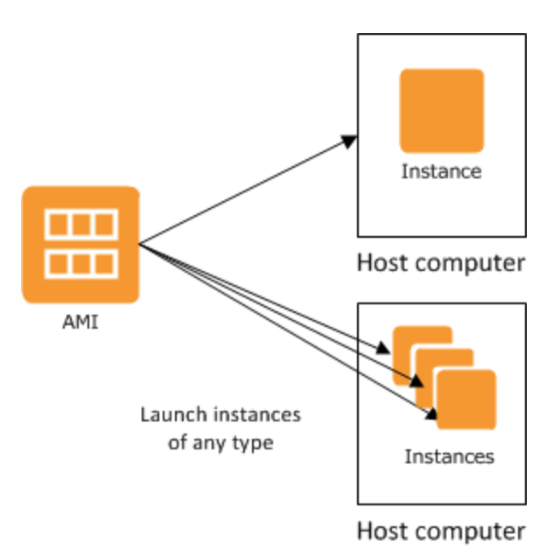
AMI’s
Amazon Web Services (AWS) publishes many Amazon Machine Images (AMIs) that contain common software configurations
In addition, members of the AWS developer community publish custom AMIs.
For example, if your application is a website or a web service, your AMI could include a web server, the associated static content, and the code for the dynamic pages

Slide 6
Instances
An instance is a virtual server in the cloud.
Its configuration at launch is a copy of the AMI specified when instance is launched
Different types of instances can launch from a single AMI.
An instance type essentially determines the hardware of the host computer used for your instance.
Each instance type offers different compute and memory capabilities.

Slide 7
Instance Types
https://aws.amazon.com/ec2/instance-types/

Slide 8
Instance Storage
More on AWS storage next week - but, in general instances can use:
Storage volumes for temporary data that's deleted when you stop or terminate your instance, known as instance store volumes
Not very common anymore. Can be faster and cheaper - but only used when you have large temp files for processing
Or
Persistent storage volumes for your data using Amazon Elastic Block Store (Amazon EBS), known as Amazon EBS volumes
Most common - must pay monthly fee per GB even if instance is stopped
https://docs.aws.amazon.com/AWSEC2/latest/UserGuide/ComponentsAMIs.html#storage-for-the-root-device

Slide 9
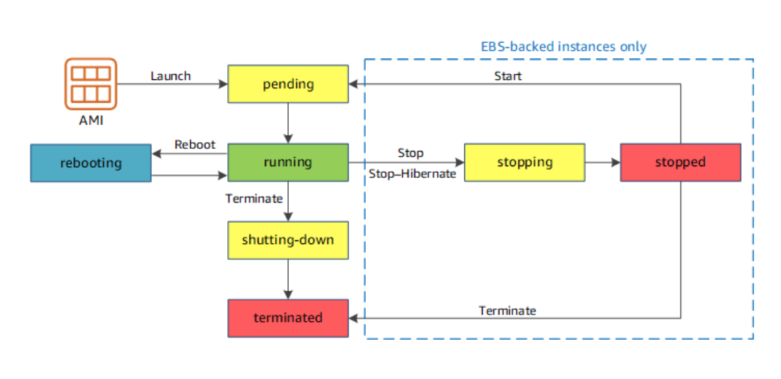
Instance Lifecycle

Slide 10
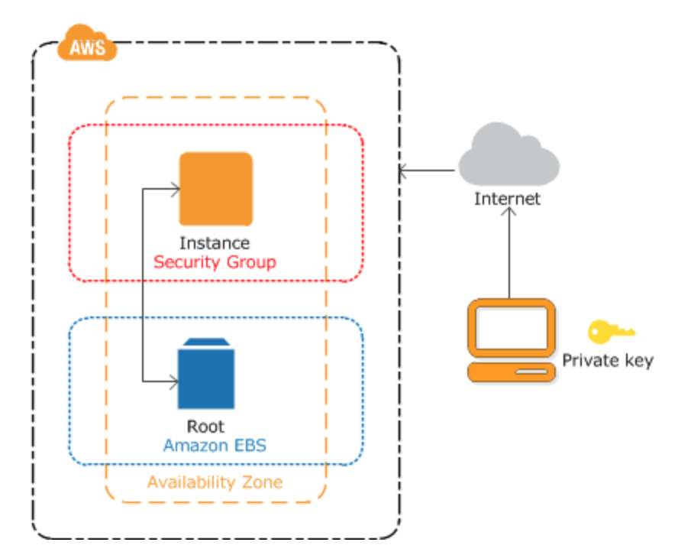
Our first lab this week!
Creating an instance
Applying our Security Group
Using our Private Key to access
Make sure to terminate when done!

